Slide 1
Design Patterns
BRIDGE
and
FLYWEIGHT

Slide 2
BRIDGE pattern
A Bridge pattern decouples an abstraction from its implementation so that the two can vary independently
e.g.
Music system
Purpose : To play music
Implementation : CD player , speakers

Slide 3
Why Bridge?
"Hardening of the software arteries" has occurred by using sub classing of an abstract base class to provide alternative implementations. This locks in compile-time binding between interface and implementation. The abstraction and implementation cannot be independently extended or composed.
Use the Bridge pattern when:
You have a proliferation of classes resulting from a coupled interface and numerous implementations
You want to share an implementation among multiple objects

Slide 4
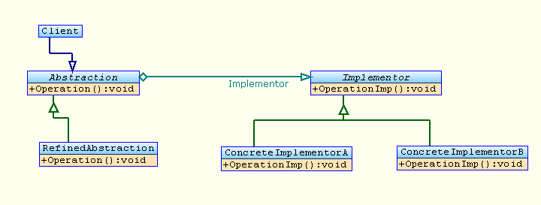
Structure

Slide 5
Structure Definition
Client
  The Object using the bridge pattern
Abstraction
  Defines the abstract interface
  Maintains the Implementer reference
Refined Abstraction
  Extends the interface defined by Abstraction
Implementer
  Defines the interface for implementation classes
ConcreteImplementor
  Implements the Implementer interface

Slide 6
Code Example
// Structural Pattern:BRIDGE
using System;
//Base class for OS implemenations
interface ImageImp
{
void DoPaint(string str);
}
//Windows specific implemenation
class WinImp : ImageImp
{
public void DoPaint(string str)
{
Console.WriteLine(str+" WIN OS");
}
}
//Abstract class for all image paintings
class Image
{
public void SetImageImp(ImageImp ip)
{
impToUse = ip;
}
public virtual void Method(string s1)
{
}
protected ImageImp impToUse;
}

Slide 7
Code Example Contd..
//BMP specific paintings
class BMPImage : Image
{
override public void Method(string s1)
{
string s2 = s1 + " BMP IMAGE";
impToUse.DoPaint(s2);
}
}
//Client
class MyPaint
{
public Image SetUpMethod()
{
Image im = new BMPImage(); // BMP IMAGE
ImageImp win = new WinImp();// WIN OS
im.SetImageImp(win);
return im;
}
}
class MyMain
{
public static void Main()
{
MyPaint mp = new MyPaint();
Image im = mp.SetUpMethod();
im.Method("PAINTING-->");
}
}

Slide 8
FLYWEIGHT pattern
The Flyweight Design Pattern is useful when there is the need for many, many objects to exist that share some
common information.
e.g
Microsoft Word Instance opening many documents in a single instance

Slide 9
Why Flyweight?
Several thousand or even several hundred thousand objects might be needed, and this is usually very memory-consuming to keep track of. Given certain constraints, it is possible to reduce this problem greatly and make the presence of so many objects possible. If all of the objects share some intrinsic, invariant information that is constant among all of them, it can be removed from each object, and referenced. This eliminates the redundancy of having to repeat the same invariant, intrinsic information for each object, so instead of storing the same information n times for n objects, it is only stored once

Slide 10
Intrinsic and Extrinsic States
Intrinsic State: The individual properties of the Flyweight object.
Extrinsic States : The properties that will be shared (acquired) by the Flyweight object while implementation.

Slide 11
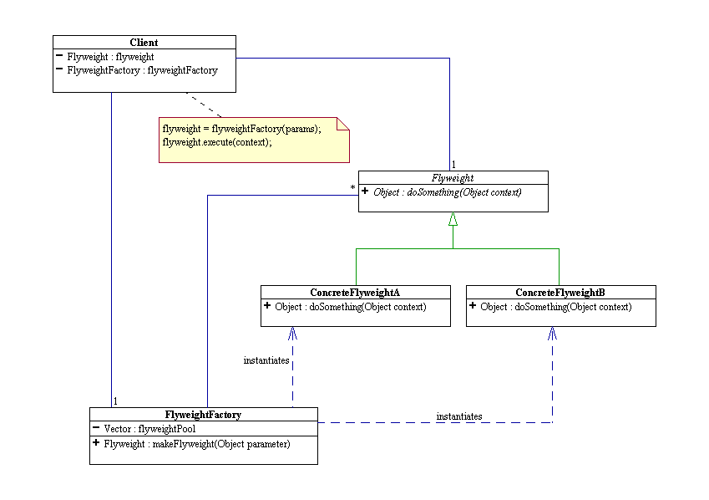
Structure

Slide 12
Structure Definition
Flyweight
The Flyweight itself is the set of intrinsic information that a set of objects share in common. It is abstract.
ConcreteFlyweight
The ConcreteFlyweight is a subclass of the Flyweight, and contains all of its information, as well as how to calculate extrinsic information for a particular (yet arbitrary) object. It is shared among more than one object.
FlyweightFactory
The FlyweightFactory serves to dispense particular flyweights requested. When a Flyweight with certain properties is requested, it checks to see if one already exists, and if so, returns that flyweight. If the requested flyweight does not exist, it creates the requisite flyweight, stores it, and then returns it.
Client
The Client, in creating a new object, must assign a flyweight to it, so it asks the FlyweightFactory for a particular flyweight, receives that flyweight, and creates a reference to it in the object it is creating.

Slide 13
Code Example
// "Flyweight"
abstract class Character
{
protected char symbol;
protected int width;
protected int height;
protected int ascent;
protected int descent;
protected int pointSize;
public abstract void Display(int pointSize);
}
// "ConcreteFlyweight"
class CharacterA : Character
{
// Constructor
public CharacterA()
{
this.symbol = 'A';
this.height = 100;
this.width = 120;
this.ascent = 70;
this.descent = 0;
}
public override void Display(int pointSize)
{
this.pointSize = pointSize;
Console.WriteLine(this.symbol +
" (pointsize " + this.pointSize + ")");
}
}

Slide 14
Code Example Contd..
// "FlyweightFactory"
class CharacterFactory
{
private Hashtable characters = new Hashtable();
public Character GetCharacter(char key)
{
Character character = characters[key] as Character;
if (character == null)
{
switch (key)
{
case 'A': character = new CharacterA(); break;
case 'B': character = new CharacterB(); break;
//...
case 'Z': character = new CharacterZ(); break;
}
characters.Add(key, character);
}
return character;
}
}
class MainApp
{
static void Main()
{
// Build a document with text
string document = "AAZZBBZB";
char[] chars = document.ToCharArray();
CharacterFactory f = new CharacterFactory();
// extrinsic state
int pointSize = 10;
// For each character use a flyweight object
foreach (char c in chars)
{
pointSize++;
Character character = f.GetCharacter(c);
character.Display(pointSize);
}
// Wait for user
Console.Read();
}
}

